Slide 2
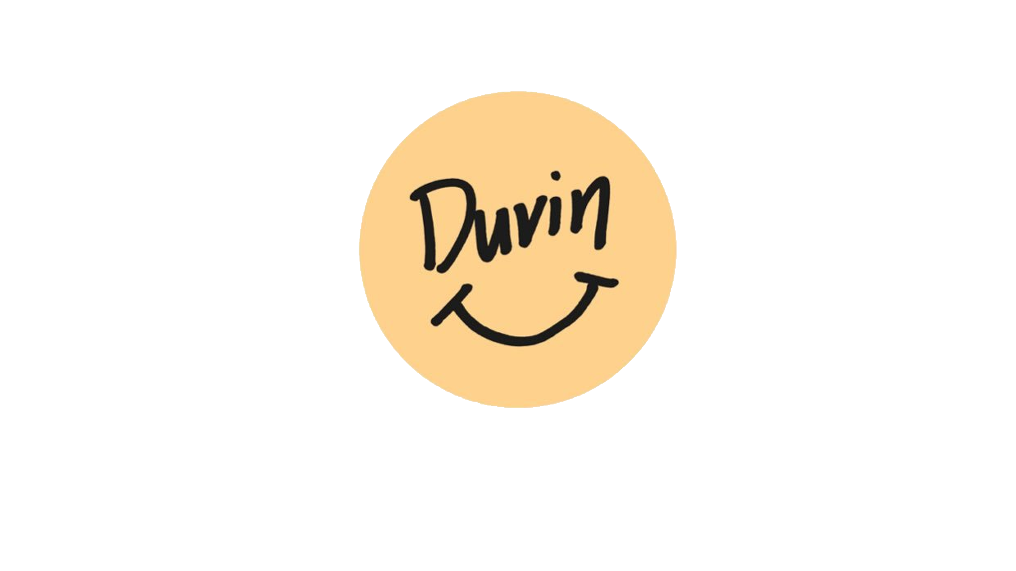
6 Years Ago…
(Duvin, 2020)

Slide 3
To Now…
brand is sold in 130 stores, 10 countries,
and worn by athletes and celebrities from all walks of life.
+
(Duvin, 2020)

Slide 4
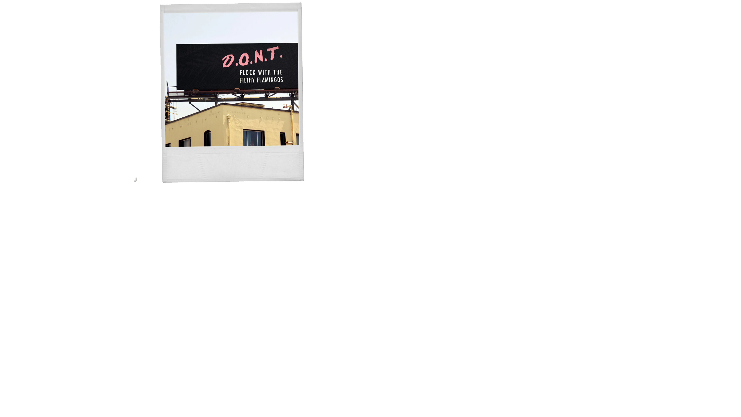
How it came to be?
A blue ocean strategy
Great social media
(Sweat, 2016)

Slide 5
Met Duvin
How I

Slide 6
How are they growing?
Authenticity
Understanding their target market
Celebrity endorsement

Slide 7
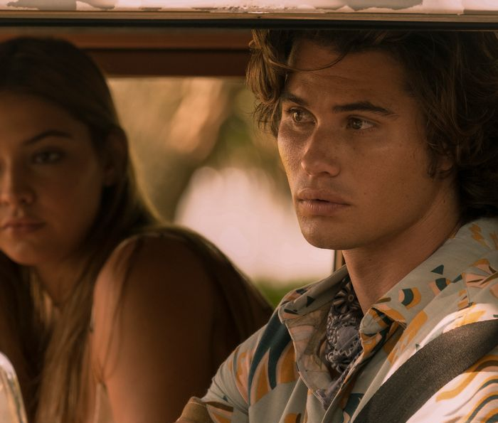
Outer Banks
(Stokes,2020)
(Petak,2020)

Slide 8
Bibliography
ABOUT US. (n.d.). Retrieved June 03, 2020, from https://duvindesign.com/pages/about-us
Carchidi, J. (2015, January 22). Duvin Design nabbing global attention for men’s surf-inspired clothing. Retrieved June 03, 2020, from https://www.bizjournals.com/orlando/blog/2015/01/duvin-design-nabbing-global-attention- for-men-s.html
Petak, T. (2020, May 12). Outer Banks Style - How to Dress Like a Pogue. Retrieved June 03, 2020, from https://www.instyle.com/fashion/outer-banks-style
Stokes, C., Cline, M., & Silvester, J. (2020, May 28). The Stars of Outer Banks Quarantined Together. Here’s the Stuff They Used Most. Retrieved June 03, 2020, from https://nymag.com/strategist/2020/05/best-stuff-for-quarantine-according-to-outer-banks- stars.html
Sweat, Z. (2016, November 08). An Interview with Austin Duvall of Duvin Design Co. - Void Magazine: Jacksonville Florida: North Florida Culture. Retrieved June 03, 2020, from https://voidlive.com/an-interview-with-austin-duvall-of-duvin-design-co/

